Slide 1
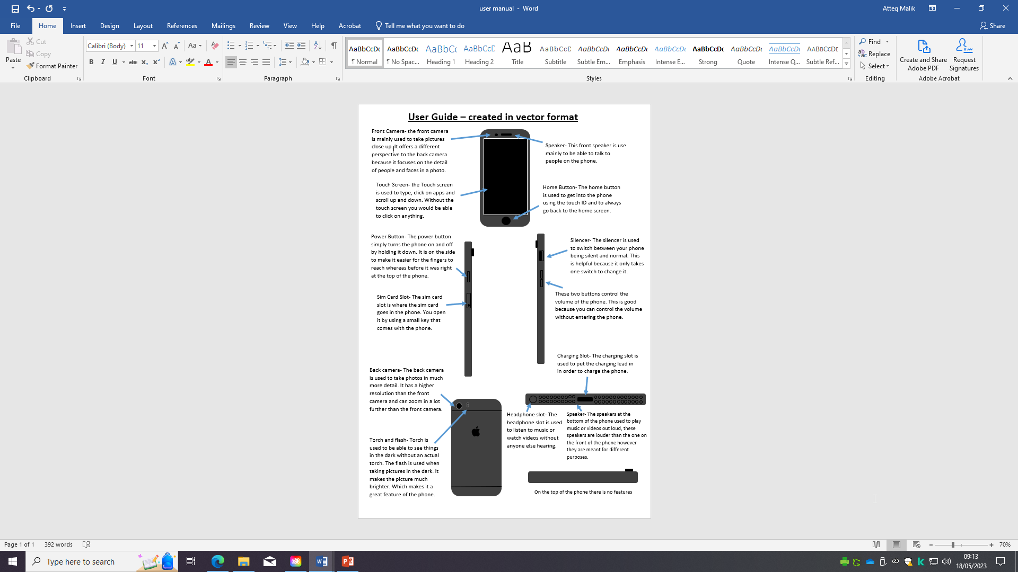
Create a user guide for a Smartphone.
You can use word or PowerPoint to design the guide.

